Slide 1
Software Development Project
QR BASED EMPLOYEE ATTENDANCE
MANAGEMENT SYSTEM
NAME=VISHAL SINGH DIVISION=SY-IT-A
ROLL NO=65 BATCH=2
GUIDE = PROF.R.S. JADHAV

Slide 2
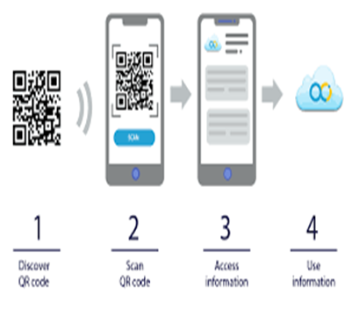
OUTLINE
INTRODUCTION
OBJECTIVE
Literature review
COMPONENTS REQUIRED
VISUAL STUDIO
PYTHON
METHODOLOGY
RESULT
FUTURE SCOPE
CONCLUSION
REFERENCES

Slide 3
INTRODUCTION
This project is designed to take down employees’ attendance using Qr code. Every employee will be having a card that contains a unique Qr code.
Each Qr code represents a unique id for all employees. They just have to scan their cards in front of the webcam on arriving and the system notes down their attendance as per date and time.
System then stores all the employees’ attendance records. It generates an overall report in database file sheet for admin and even allows him to search for particular employees attendance.

Slide 4
OBJECTIVE
Attendance Management keeps track of your employee.
It enables the data to use in an efficient way.
Ensuring data safety through the modern new technologies.
Attendance Management can be done by recording employee hours on paper, using spreadsheets, punching time cards.By using this Management System we can easily handle a large amount of the data.

Slide 5
Literature review
S.No | Name of the Paper | Year | About Paper
1 | QR Code Based Smart Attendance System | 2020 | QR Code Based Attendance Management System” is a combination of two android applications developed for taking and storing the attendance of the students on the daily basis in the college. the overall attendance sheet in CSV/XLS. An Android app that take the attendance with respect to the specific subject and generate the student attendance sheet as per attendance details.
2 | Employee Attendance System using QR Code | 2020 | The system uses QR Code for authenticating employees with a unique QR Code that represents their unique id. Every employee is provided with a card that contains the QR Code. They just have to scan their cards using QR Code reader and the system notes down their attendance as per date and time. System then stores all the employees’ attendance records and generates a brief reports for admin as required in excel sheet.

Slide 6
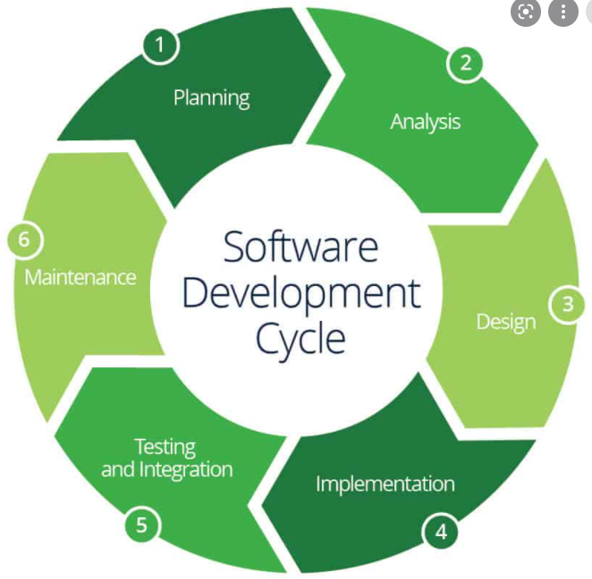
COMPONENTS REQUIRED
Laptop or PC
Visual Studio Software.
Knowledge of Python.
Knowledge of the Sqlite.

Slide 7
Visual Studio
Microsoft Visual Studio is an IDE made by Microsoft and used for different types of software development such as computer programs, websites, web apps, web services, and mobile apps. It contains completion tools, compilers, and other features to facilitate the software development process.
Visual Studio is good for Python. It is one of the coolest code editors available to programmers, Visual Studio Code, is an open-source, extensible, light-weight editor available on all platforms. It's these qualities that make Visual Studio Code from Microsoft very popular, and a great platform for Python development.
In Visual Studio Code, we have support for almost every major programming language. For example, JavaScript, TypeScript, CSS, and HTML but more rich language extensions can be found in the Visual Studio Code.

Slide 8

Python
Python is a high-level, interpreted, interactive and object-oriented scripting language. ... It uses English keywords frequently where as other languages use punctuation, and it has fewer syntactical constructions than other languages. Python is Interpreted − Python is processed at runtime by the interpreter.
Benefits Of Python Language
Easy to learn
Procedural Programming
Compatible with Most Systems and Architectures
No License needed
Data Science and AI
Web Development
Presence of Libraries
Open Source and free

Slide 9
METHODOLOGY
Create EmployeeDetails Table with fields employee_name, employee_id, employee_contact, employee_department.
View records from the table that we have created.
Generate QR Code of the employees.
Scan the QR Codes of the Employees and take attendance.
Provide the salary to the Employee according to his presentis.
Operation several operations on it.

Slide 10
RESULT
The Employee’s attendance status will be analysed and exported.
Attendance monitoring system .
It is an efficient method to store the attendance in the smart way rather than wasting the paper.
We can search record in this management system even within seconds.
All data will be secure and and be preserved till as we want to preserved.

Slide 11
FUTURE SCOPE
Some GUI part should also be added in this project .
Try to use Tkinter in python in my project.
Options like add voice or/and video recording functionality can be added.
It also produce sound when any commands start .
Try to give it best shape .

Slide 12
CONCLUSION
The Employee’s attendance status will be analysed and exported.
Attendance monitoring system is very important in our daily life.
It is possesses a really great advantage, among the whole types of code scanning technology, QR Code Based Smart Attendance System is the most accurate.
In this project , we have given an introduction of Attendance monitoring system and its advantage.
It is an efficient method to store the attendance in the smart way rather than wasting the paper

Slide 13
REFERENCES
https://www.codewithharry.com/videos
https://stackoverflow.com/
https://www.researchgate.net/publication/318779349_QR_Code_Based_Smart_Attendance_System
https://nevonprojects.com/employee-attendance-system-by-qr-scan/
https://www.allgeo.com/qr-code-employee-attendance-and-monitoring-system

Slide 14
THANK YOU!!!

